Slide 1

Crisis Management and Alarm System(CMAS)
Guided by,
Ms. T. Subha.M Tech,(Ph.D)
By,
S. Siva Hari Ganesan
S. Mukesh Kumar
M. Ashwin

Slide 2
Contents
Objective
Abstract
Problem Definition
Existing System
Proposed System
Architecture
Module 1 : User Registration
Module 2 : Report Crisis
Module 3 : Authenticate Crisis and send Alarms
Hardware and Software Requirements
Advantages
Disadvantages

Slide 3
Objective
Human population is under constant threat from natural disasters.
The nature of the disaster influences the kinds of threats that humans are exposed to by physical phenomena.
In this study, an early warning system with the capability of a mobile platform, is developed to report disasters.

Slide 4
Need for this System
In the event of a crisis, proper guidance needs to be provided to the general public to prevent casualties.
The civilians should be directed to a refuge center.
Mobile platform provides a personal reach to guide civilians.

Slide 5
Problem Definition
Lack of proper medium for government to communicate with the civilians in distress.
Many civilians are stranded in the event of crisis.
They need to be directed to a safe location to avoid panic among themselves.

Slide 6
Existing System
Building various warning centers in various district and rural areas.
A centralized system is established to monitor the centers in the district and rural areas.
Central unit informs the sub-ordinate divisions on the guidelines to be provided to the masses.

Slide 7
Proposed System
The technical virtuoso of the mobile platform is exploited to provide personal information to the public.
The mobile numbers of the civilians in the crisis region are extracted from the crisis alert system’s database.
The SMS gateway is used to interface between the system and mobile network’s SMSC(Short Message Service Center).
The information is passed as text messages.

Slide 8
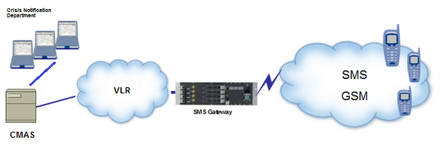
Architecture

Slide 9
Module 1 :
A user needs to register into the crisis alert application.
All user information and credentials are stored in the database for future references.
JasonParser class is used to create database connection and registers user’s mobile number .

Slide 10
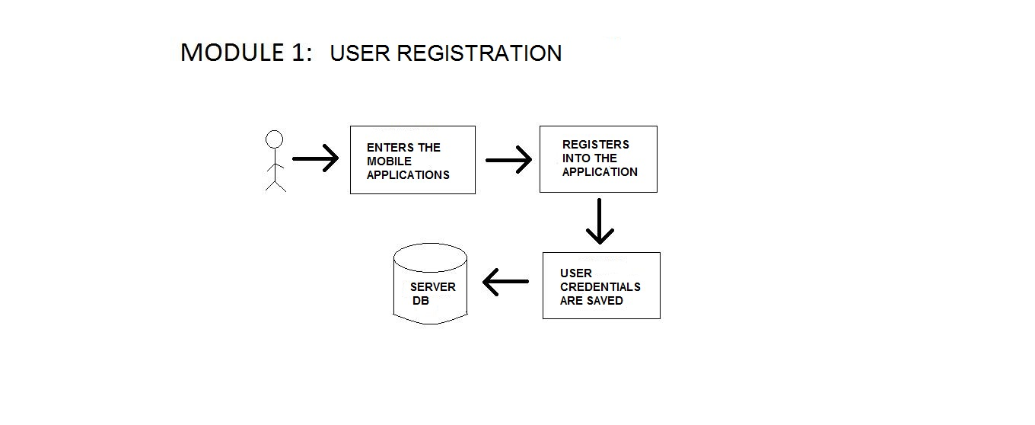
Module 1 :
Architecture -

Slide 11
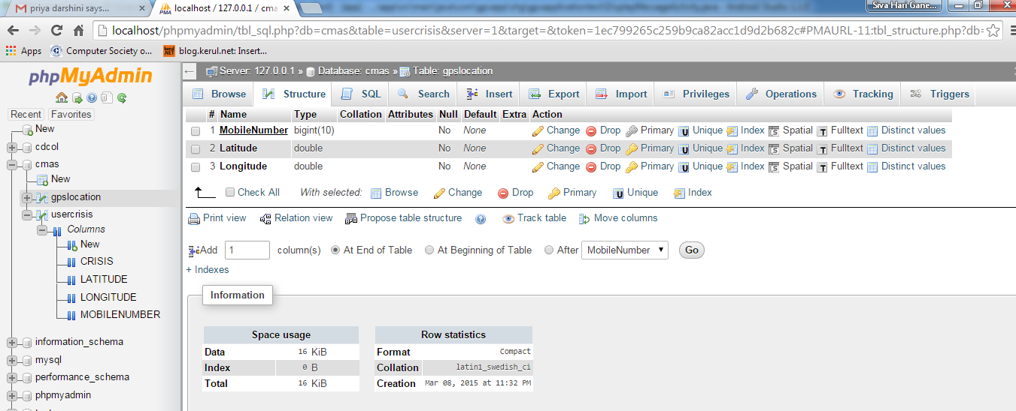
Module 1 : Implementation

Slide 12
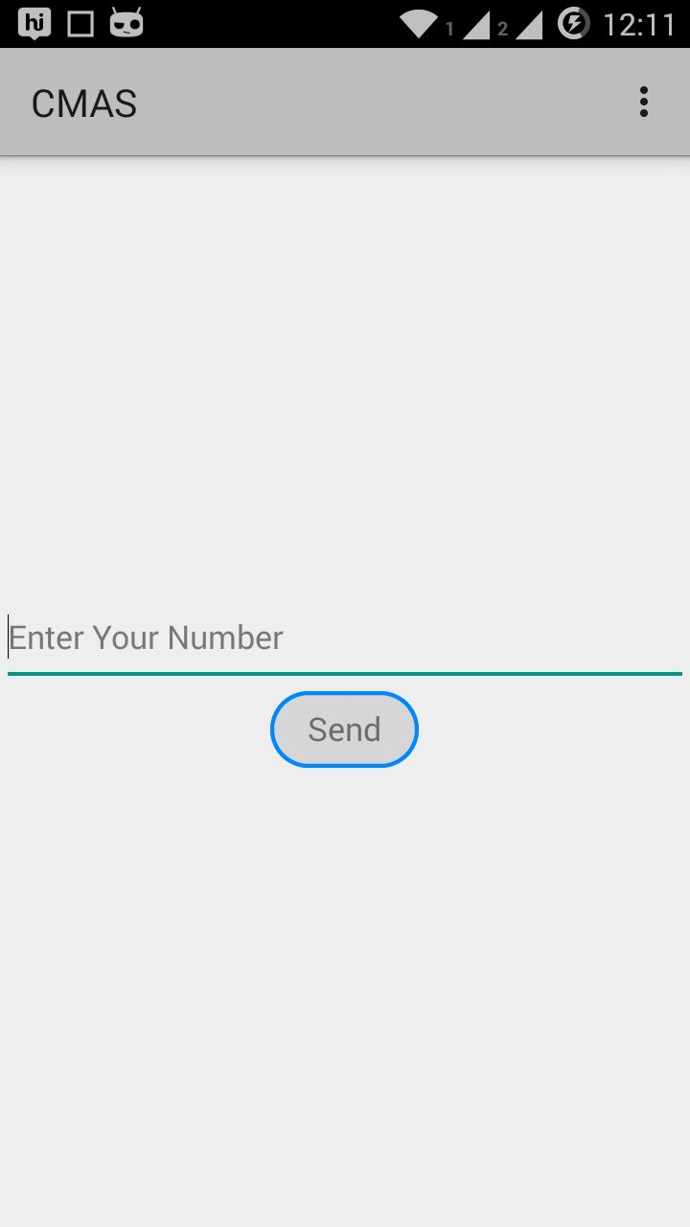
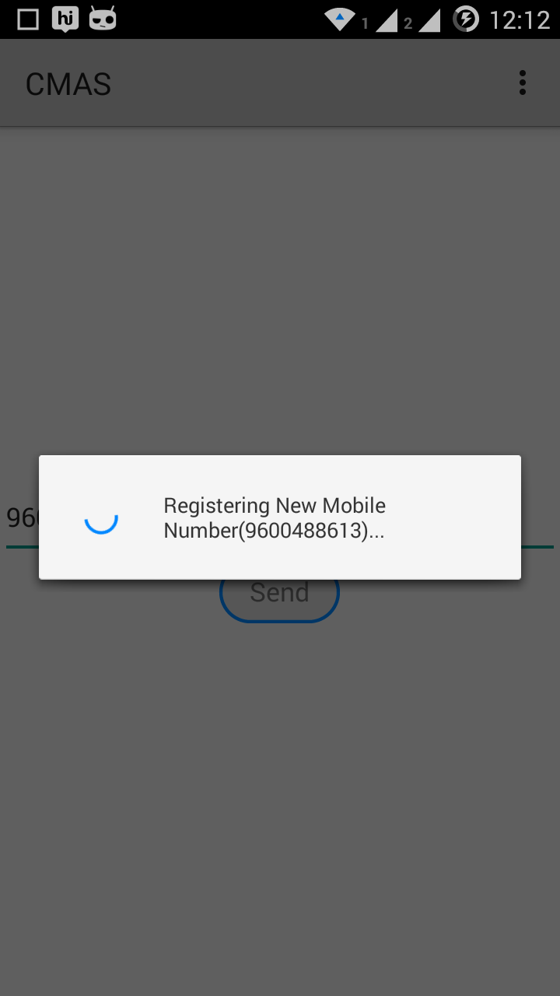
Module 1 : Implementation

Slide 13
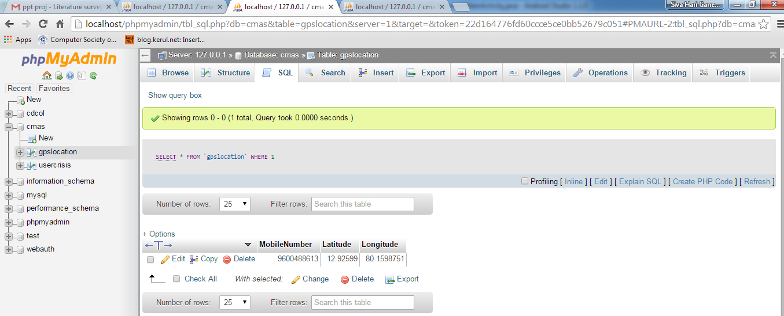
Module 1 : Implementation

Slide 14
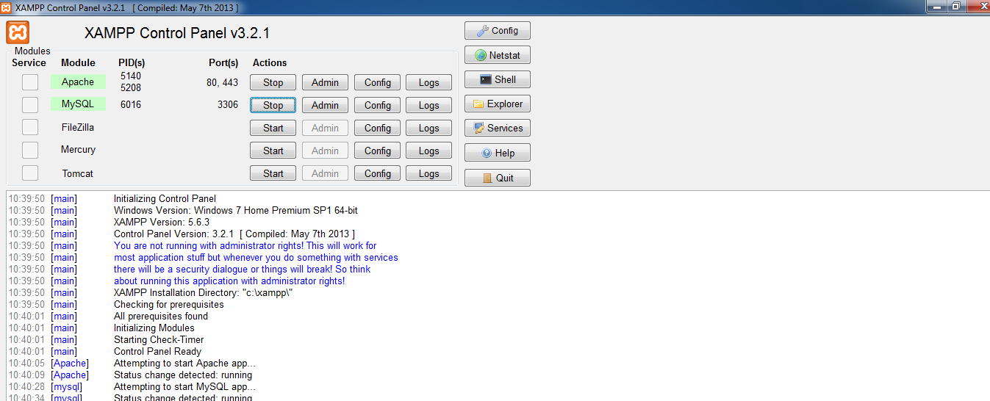
Module 1 : Implementation

Slide 15
Module 2 : Report Crisis
In the event of any crisis, the application allows the end user to report the event to the nearby government facility.
The Gps technology present in the device sends the coordinates of the user to the centers.
The application in the device sends the crisis report along with the user location and the user’s mobile number to the webserver.

Slide 16
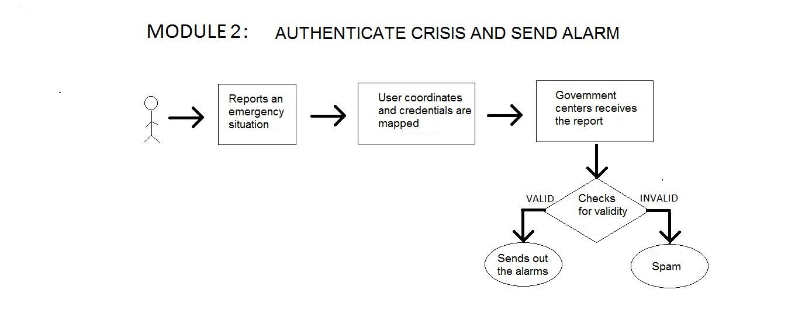
Module 2 : Architecture

Slide 17
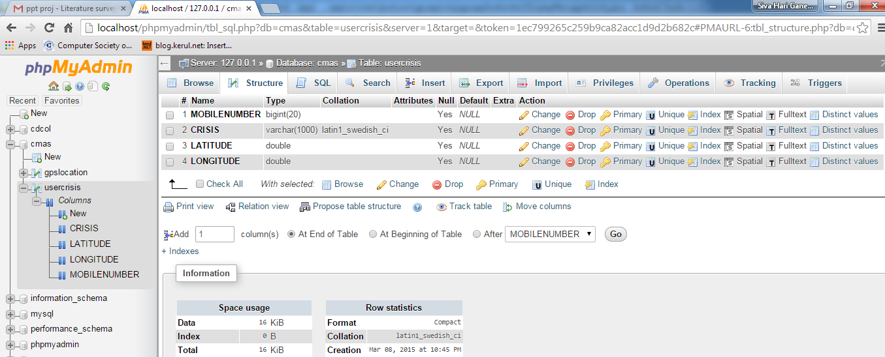
Module 2 : Implementation

Slide 18
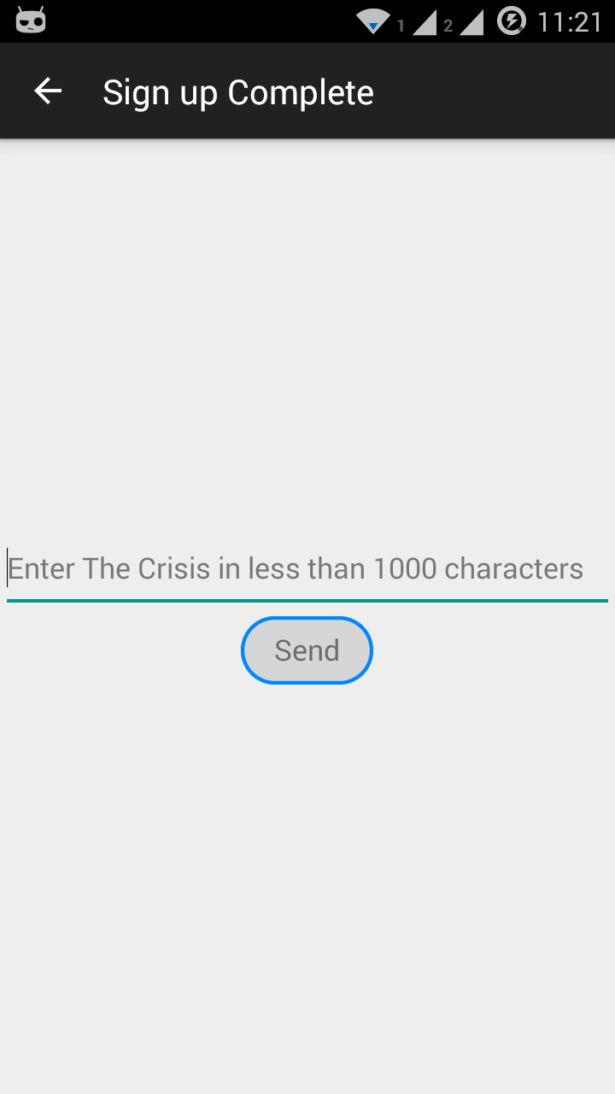
Module 2 : Implementation

Slide 19
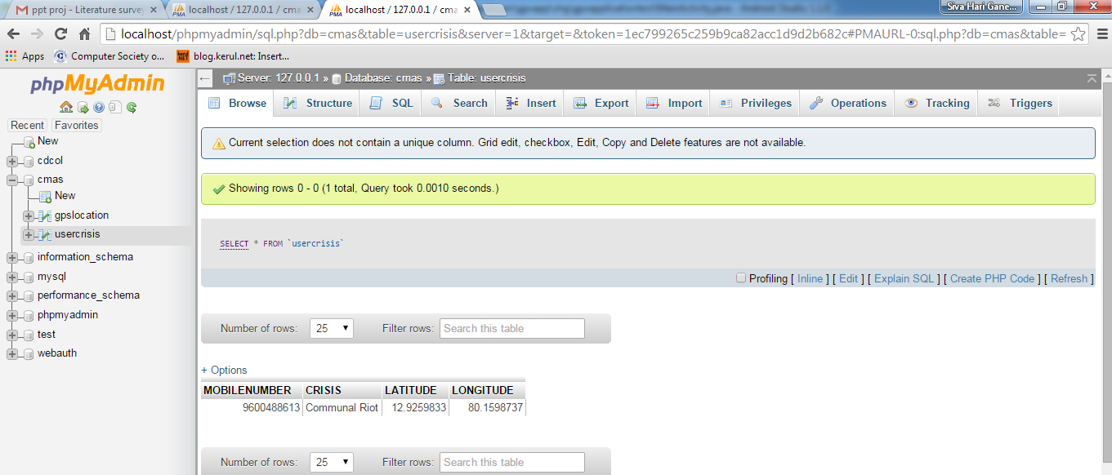
Module 2 : Implementation

Slide 20
Module 3 : Authenticate crisis and send Alarms
SMS Gateways provides an interface between the system and the mobile network’s SMSC.
The designed relief message and its recipients is uploaded in the gateway.
The SMPP(Short Message Peer to Peer) protocol is typically used to broadcast the messages by the SMS Gateway.

Slide 21
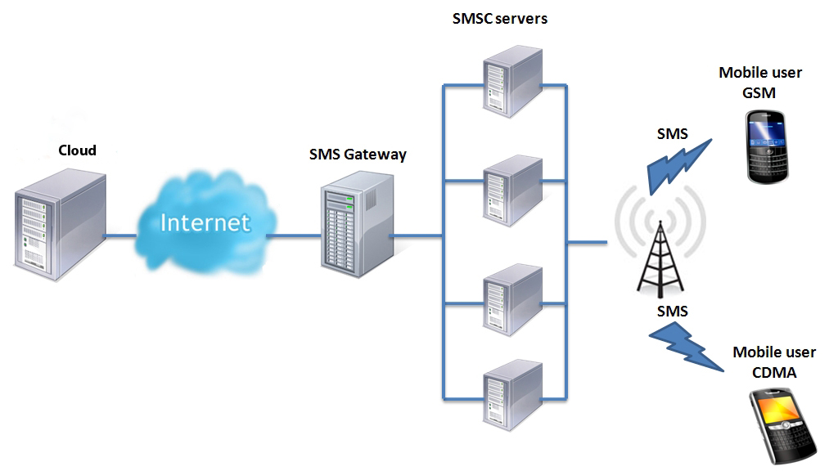
Module 3 : Architecture

Slide 22
Hardware and Software Specifications
Cloud (Platform As a Service)
License to access service provider’s VLR.
SMS Gateway applications

Slide 23
Hardware and Software Specifications
Android version – Minimum froyo.
Android ADB.
SMS Gateway applications

Slide 24
Advantages
Provides a personal reach to pass information between the government and the public.
Maintenance is low
Cost effective
Assured delivery of relief messages.

Slide 25
Disadvantages
Requires the users to register with the application database.
A secure cloud applications needs to be used to safeguard the mobile information.

Slide 26
References
DWAS (Disaster Warning and Alert System) a Public Works Department project.
Sms Gateway - http://en.wikipedia.org/wiki/SMS_gateway
Network Sub switching - http://en.wikipedia.org/wiki/Network_switching_subsystem

Slide 27

Queries..??

